Slide 1
API TESTING TOOLS

Slide 2

PLAN
DEV-TOOL
POSTMAN
-------------------
FIDDLER
SOUP UI

Slide 3
Recourses
https://rapidapi.com/apilayernet/api/rest-countries-v1?endpoint=53aa5a08e4b0a705fcc323a6
http://countries.petethompson.net/data/geo/afg.geo.json
http://dneonline.com/calculator.asmx?wsdl
https://speller.yandex.net/services/spellservice?WSDL - HW

Slide 4
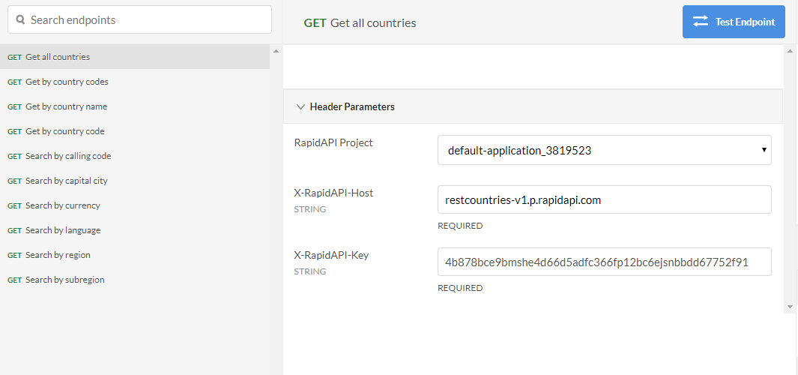
REST Countries

Slide 5
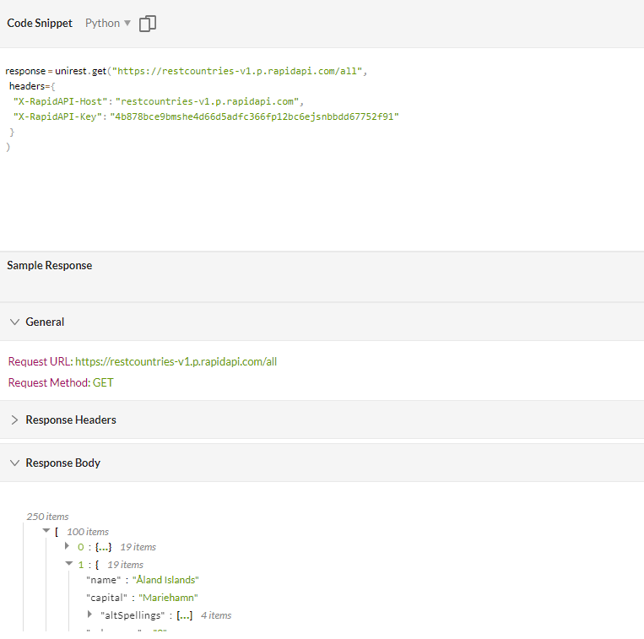
REST Countries

Slide 6
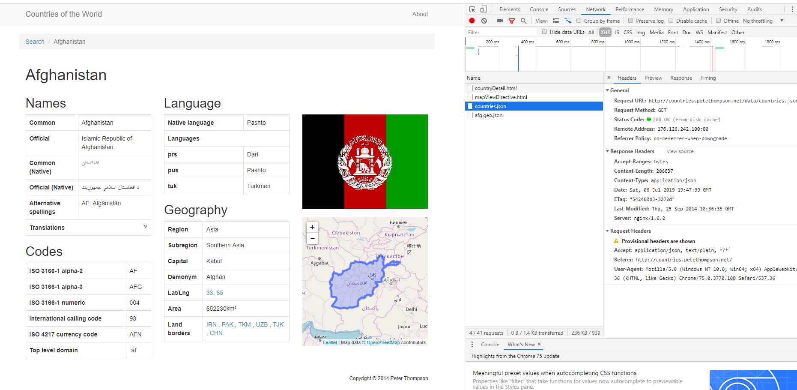
DEV TOOL

Slide 7
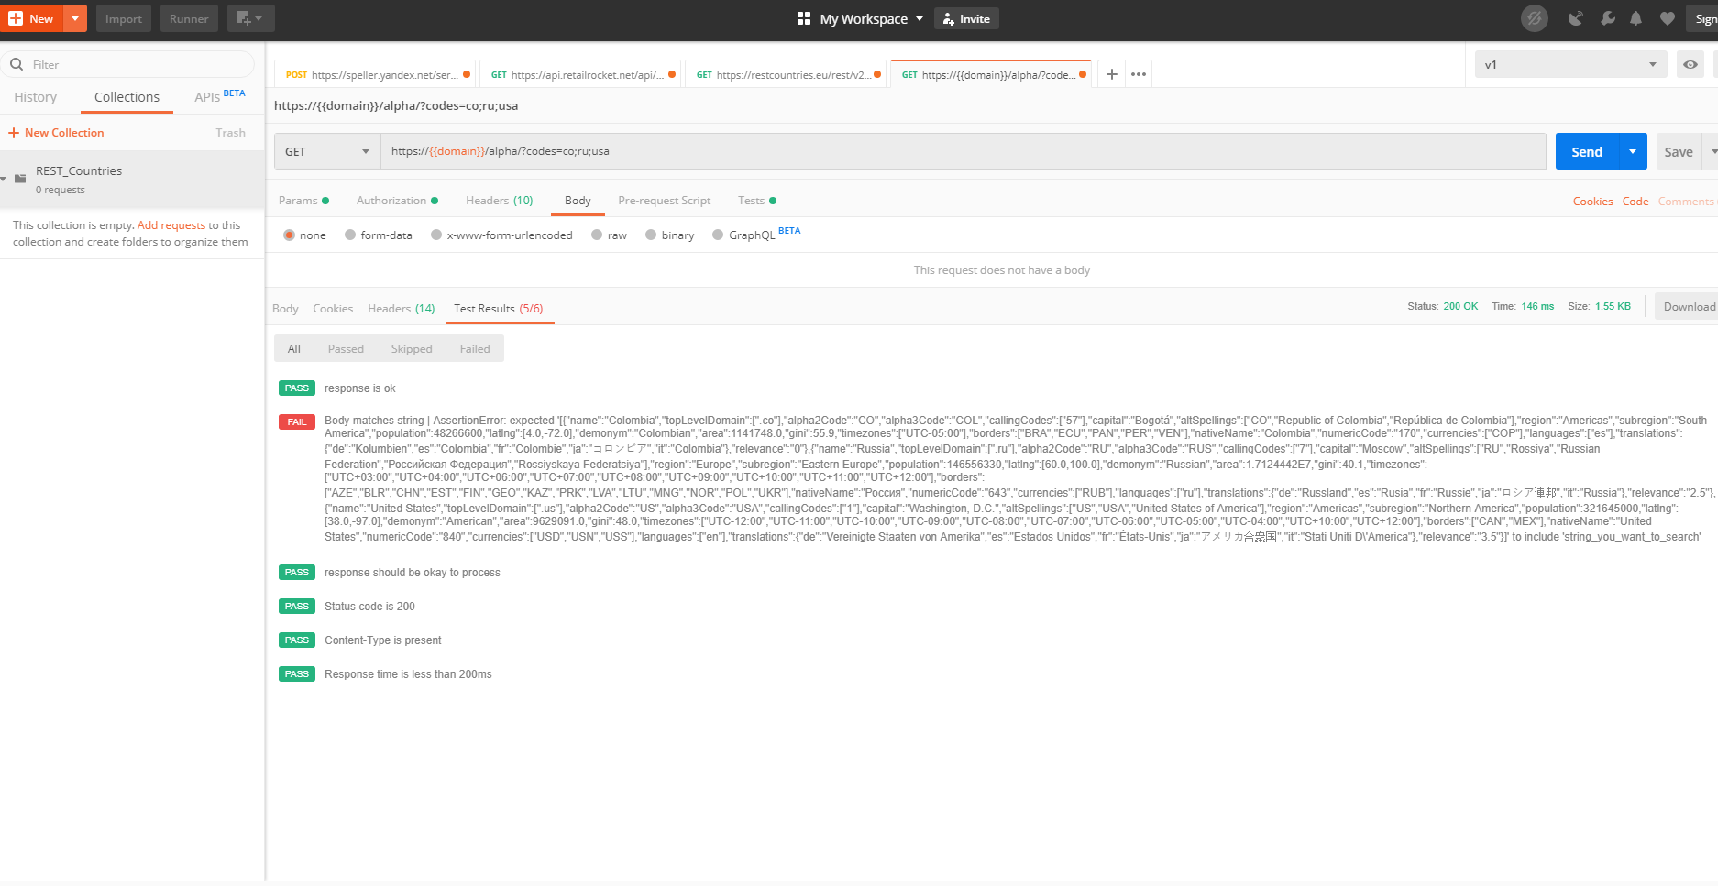
POSTman

Slide 8
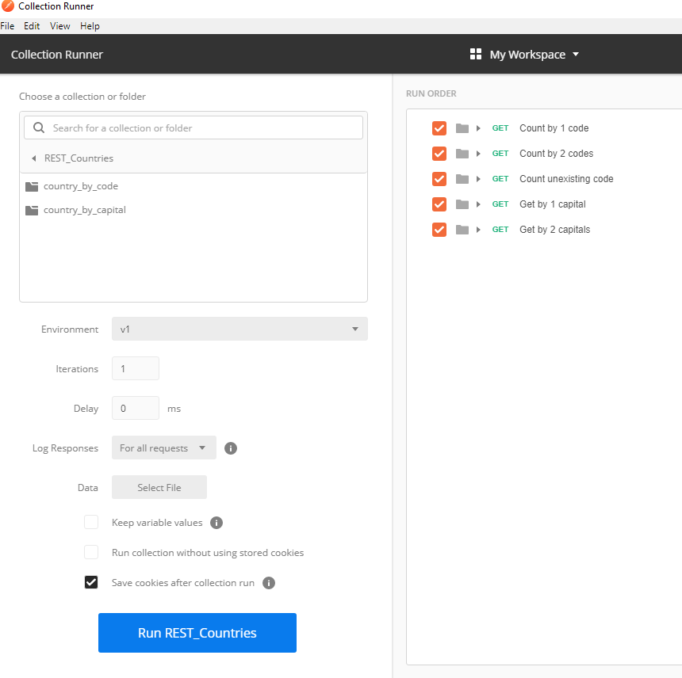
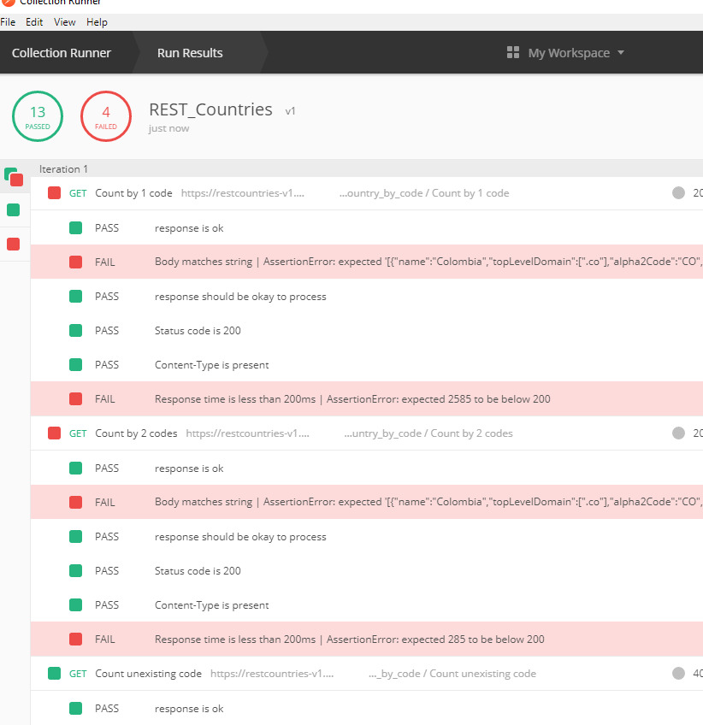
POSTman

Slide 9
POSTman
Send http requests and display result
Supply group of variables
Execute tests for the response
Create collections

Slide 10
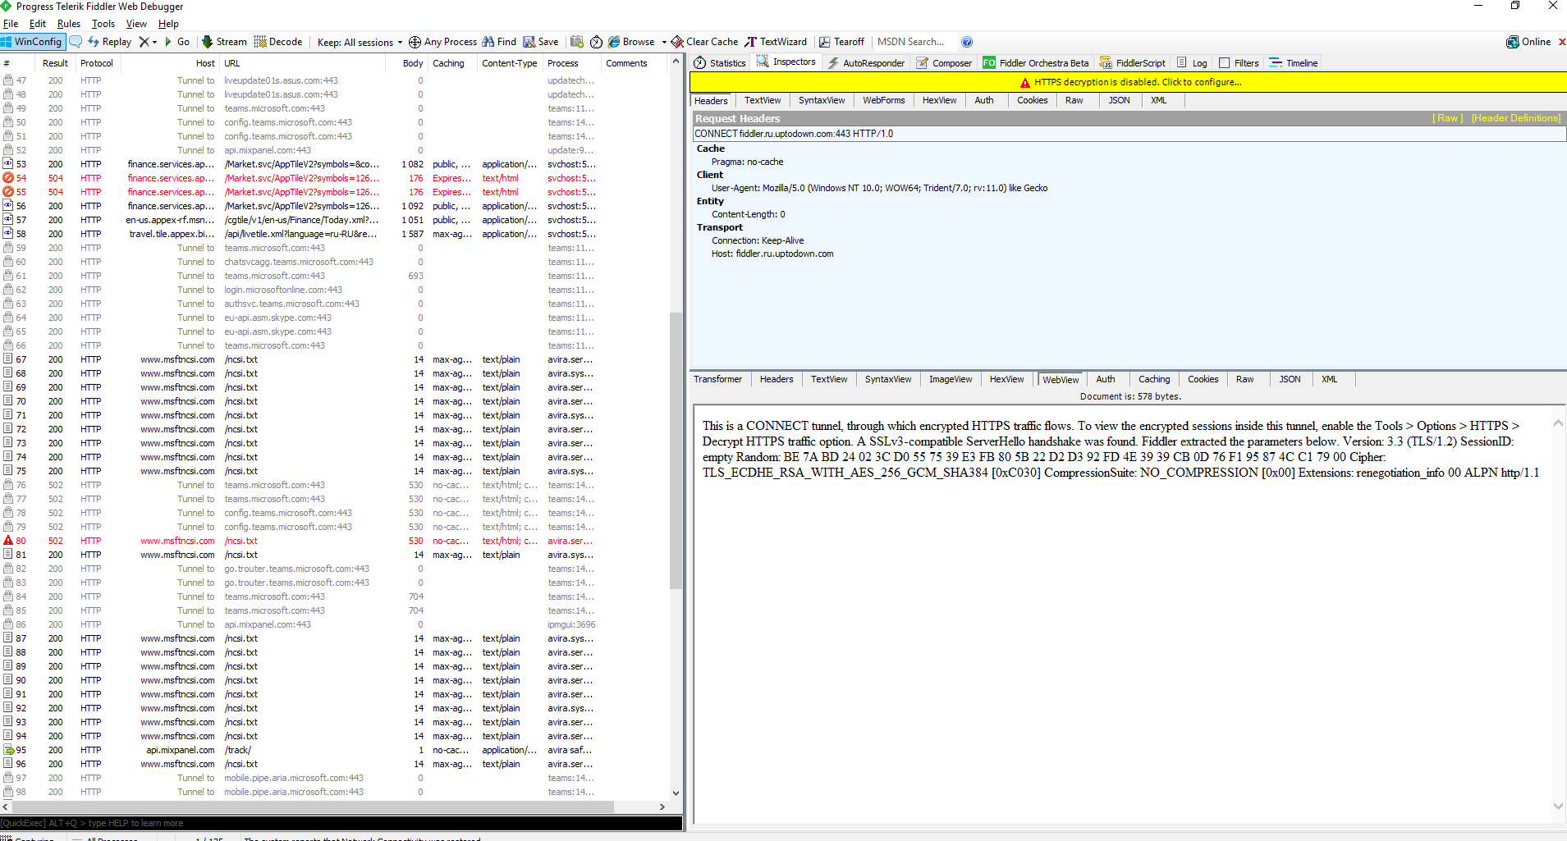
FIddler

Slide 11
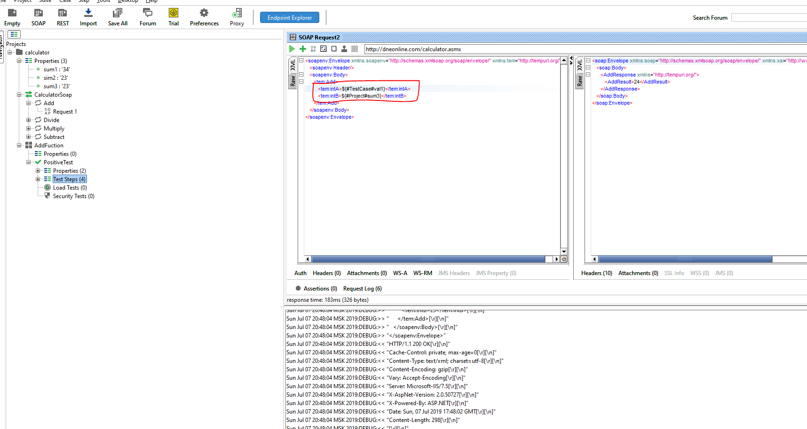
Soapui supply property

Slide 12
Rest Assured
Configure request + request configuration
Assert response
Gerkin style (given-when-then)
Json validation, serialization/de-serialization
Autentification

Slide 13
Rest Assured
Rest Assured
TestNg
Lombok
Gson ()
Autentification

Slide 14
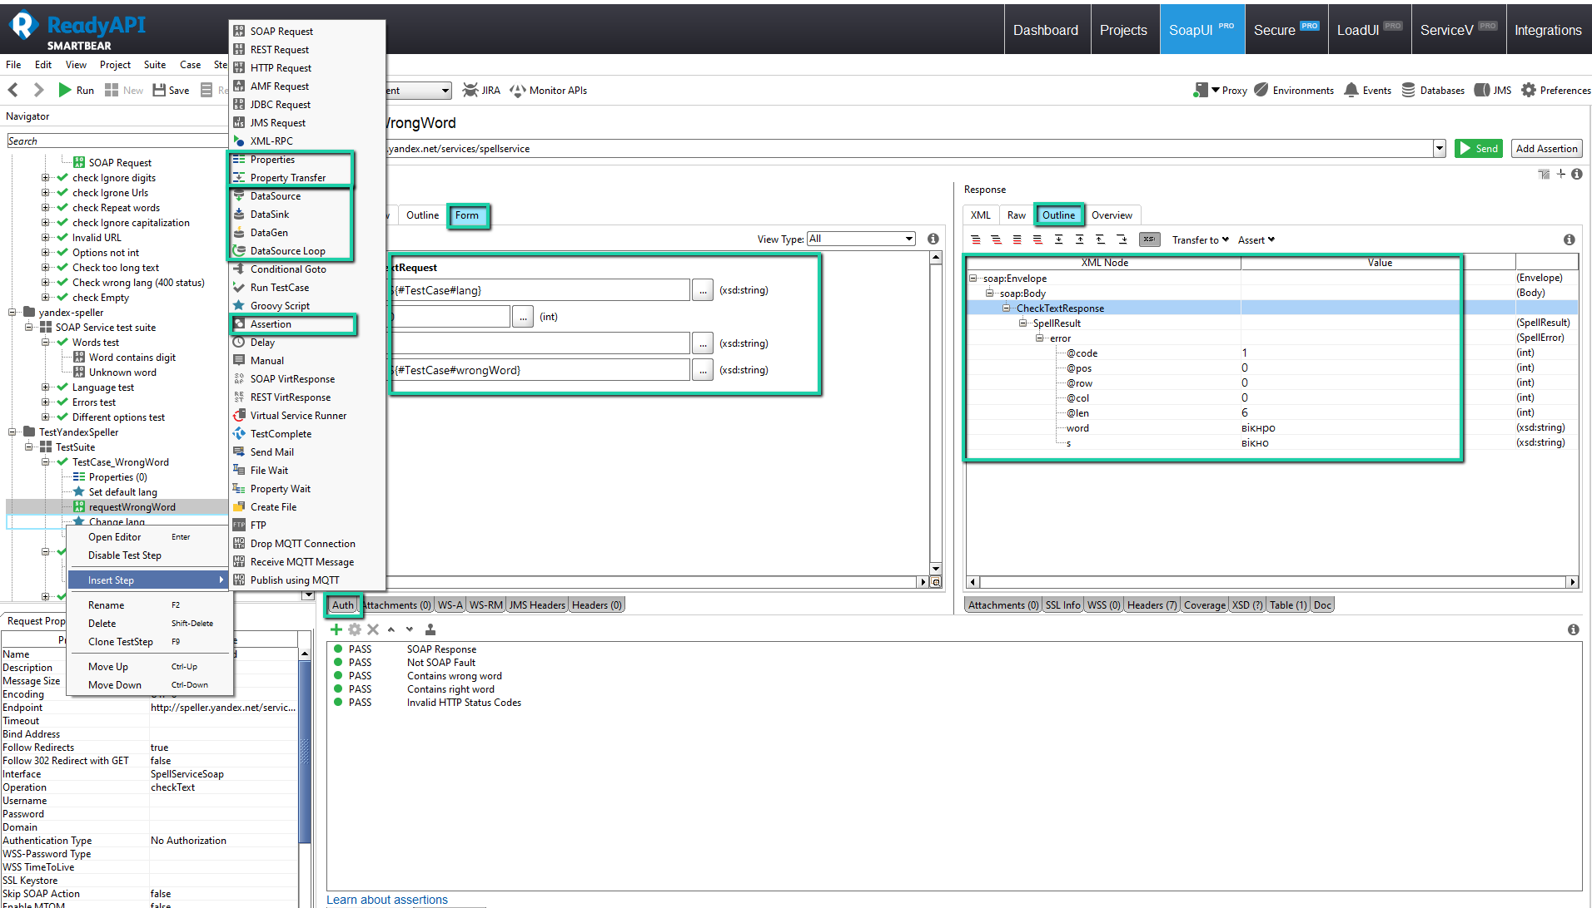
SOUP UI PRO

